Slide 1
Random Forest ensembles for detection and prediction of Alzheimer's disease with a good between-cohort robustness
A.V.Lebedev, E.Westman, G.J.P.Van Westen, M.G.Kramberger, A.Lundervold, D.Aarsland, H.Soininen, I.Kłoszewska, P.Mecocci, M.Tsolaki, B.Vellas, S.Lovestone, A.Simmons
NeuroImage: Clinical, Volume 6, 2014, Pages 115-125

Slide 2
Introduction
Problems with pattern recognition approaches to neuroimaging:
  Sensitive to MR-protocol differences
  High-dimensional imaging data vs parceled data
    Imaging data => Computation and memory costs
    Parceled data => biased
  Curse of dimensionality
    Number of measurements >> number of observations
    Dimensionality reduction

Slide 3
Introduction
Random forests
  Ability to handle highly non-linear biological data
  Robustness to noise
  Tuning simplicity
  Opportunity for efficient parallel processing
  Good at handling high-dimensional problems
Hypothesis
  Use of more disease-specific parcellation atlases => achieve AD-detection accuracy equivalent to that of the models trained with high-dimensional input without parcellation in shorter computational time.
  it is possible to achieve good between-cohort generalization of the models if the MRI protocols are harmonized.

Slide 4
Data
ADNI database
  575 subjects
    Training
      150 AD
      150 HC
    Testing
      35 AD
      75 HC
      165 patients with mild cognitive impairment (MCI)
AddNeuroMed study
  321 subjects
    107 AD
    114 MCI
    100 HC
  Split into 6 subgroups according to the month of MCI-to-AD conversion during 4 years of follow-up
Cortical pattern of relevance for AD detection: HD morphometric data. The figure illustrates regions, which were the most relevant for AD detection based on the mean decrease of the Gini index. In all three HD modalities, the pattern was AD-specific and included changes predominantly in temporal lobes (with maximum relevance of entorhinal region).

Slide 5
Image Post-processing
Image quality control was performed using standardized procedures
surface-based cortex reconstruction and volumetric segmentation using the Freesurfer image analysis software
  morphometric modalities (cortical thickness, Jacobian maps, and sulcal depth).
cortical models from each individual were registered to a spherical atlas, providing matching across subjects
327,684 normalized measurements acquired for every subject were concatenated into large matrices (one for each high-dimensional morphometric modality).

Slide 6
Statistical analysis
using the R programming language
Demographic and clinical features were compared using parametric and non-parametric tests as appropriate.
Principal component analysis (PCA) fromthe R ‘base’ packagewas usedwith visual inspection of PCA score-plot for the outlier detection

Slide 7
Parameter selection and classification
R package ‘caret’ was used to implement recursive feature elimination (RFE) based on the Gini-criterion with 5-fold cross-validation
Models (modalities)
  cortical thickness
  sulcal depth
  Jacobian maps
  non-cortical volumes
  combined parceled measurements of cortical thickness and non-cortical volumes

Slide 8
Parameter selection and classification
measurements with near-zero variance were removed from the feature sets and the resulting output underwent stepwise RFE
10,000 trees were used to “grow” the first forest (using full feature set)
RFE was performed based on feature importance vector derived from the first forest, by removing the lowest-ranked 5% of the features at each step (gradually reducing the dimensionality as 100%, 95%,…etc., up to 50%), and by the subsequent accuracy comparison with 5-fold CV
to reduce CPU, RAM and time usage the forests were trained with 1000 trees (instead of 10,000 for the first forest) at each step of RFE
After selection of the optimal feature subset, $m_{try}$-parameter adjustmentwas also performed using 1000 trees ($search range∈\left[\frac{\sqrt{N_{features}}}{4};\sqrt{N_{features}}∗2.5\right],step=\frac{\sqrt{N_{features}}}{4}$)
the forests were retrained with optimal parameters using 10,000 trees

Slide 9
Parameter selection and classification
At every split node τ one of the $m_{try}$variables, say $x_{k}$, is used to form the split and there is a resulting decrease in the Gini index
The mean decrease of the Gini index, $∆i\left(τ\right)$ was used as a metric
  $∆i\left(τ\right)=i\left(τ\right)−\left(p_{L}i\left(τ^{L}\right)+p_{R}i\left(τ^{R}\right)\right)$
  Where $i\left(τ\right)=1−\sum_{c∈C}{p_{c}^{2}}$ is the Gini index at node $τ$, $p_{L}=\frac{\left|S_{j}^{L}\right|}{\left|S_{j}\right|}$, and $p_{R}=\frac{\left|S_{j}^{R}\right|}{\left|S_{j}\right|}$ are the probabilities of sending a data point to the left and right nodes, respectively

Slide 10
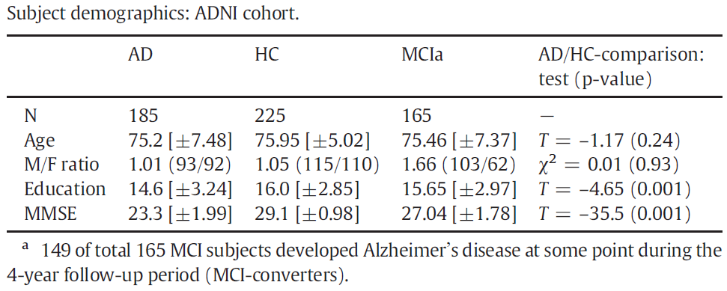
Results
main demographic characteristics
  Significant differences between AD and HC subjects were observed in education, in addition to word recall

Slide 11
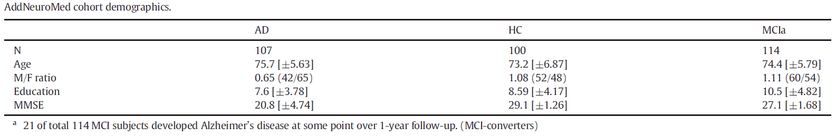
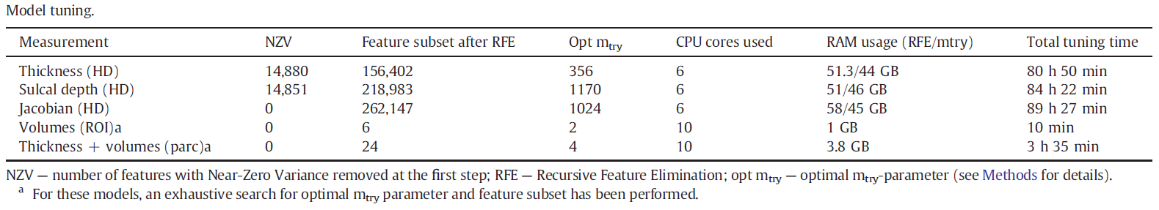
Results
Demographics
Model tuning

Slide 12
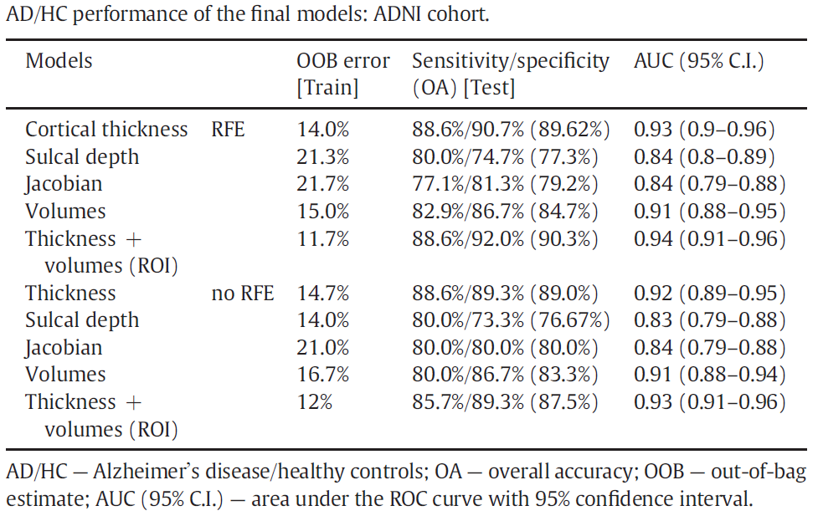
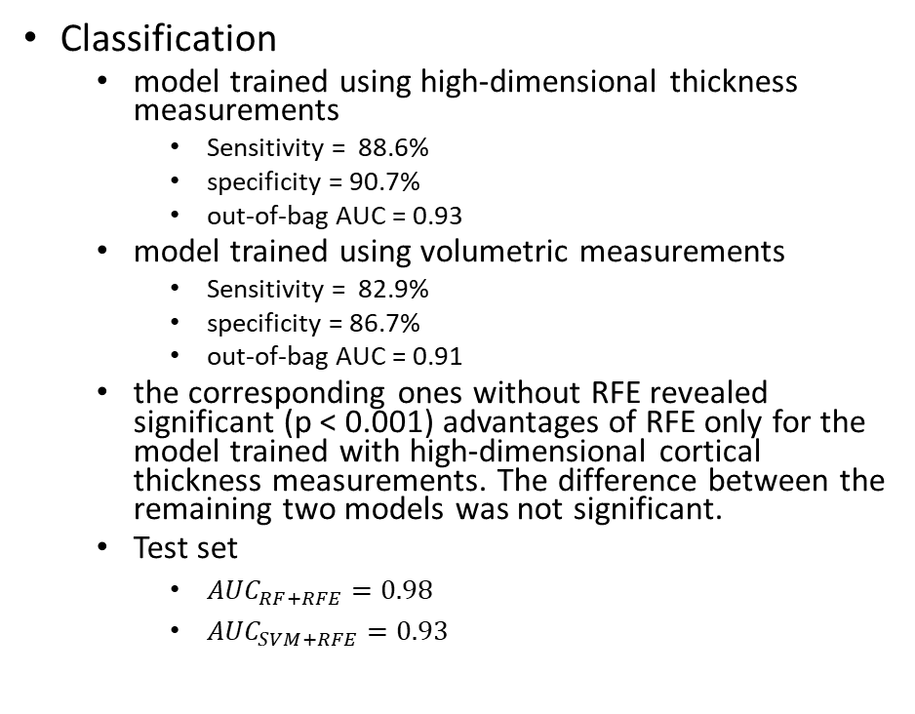
Results
Classification
  model trained using high-dimensional thickness measurements
    Sensitivity = 88.6%
    specificity = 90.7%
    out-of-bag AUC = 0.93
  model trained using volumetric measurements
    Sensitivity = 82.9%
    specificity = 86.7%
    out-of-bag AUC = 0.91
  the corresponding ones without RFE revealed significant (p < 0.001) advantages of RFE only for the model trained with high-dimensional cortical thickness measurements. The difference between the remaining two models was not significant.
  Test set
    ${AUC}_{RF+RFE}=0.98$
    ${AUC}_{SVM+RFE}=0.93$

Slide 13
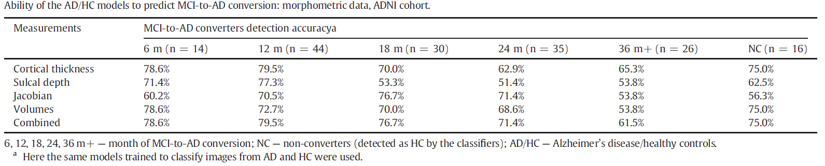
Results
Best ability to predict MCI-to-AD conversion based on imaging data only was observed for the model in which all RF ensembles were combined by a majority vote, and was achieved at 76.6% in overall MCI-to-AD conversion detection sensitivity, 2 years before actual dementia onset (averaged value for 6th-, 12th-, 18th- and 24th-month converters) with a specificity of 75.0%

Slide 14
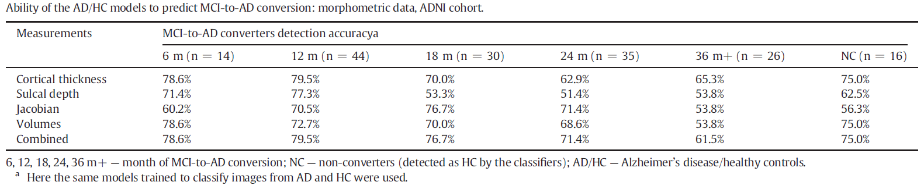
Results
Robustness in different cohorts
  best stability (both for AD detection and prediction) was found for the models trained with high-dimensional measures of cortical thickness and parcelled thickness with volumetric measures. Combined models trained using both imaging and non-imaging data demonstrated absence of accuracy drop

Slide 15
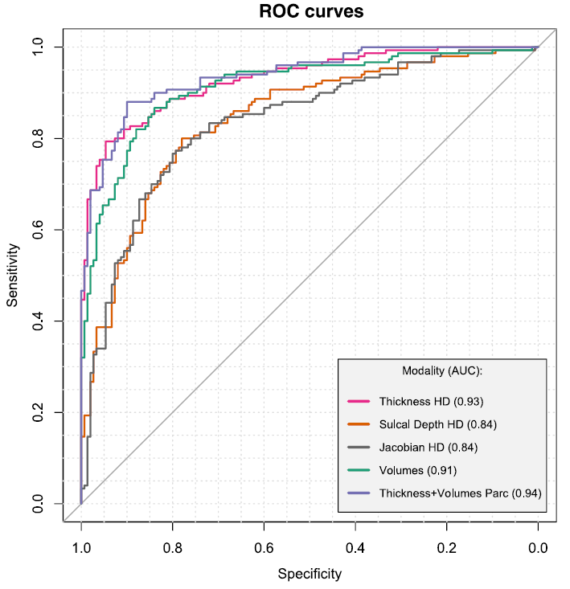
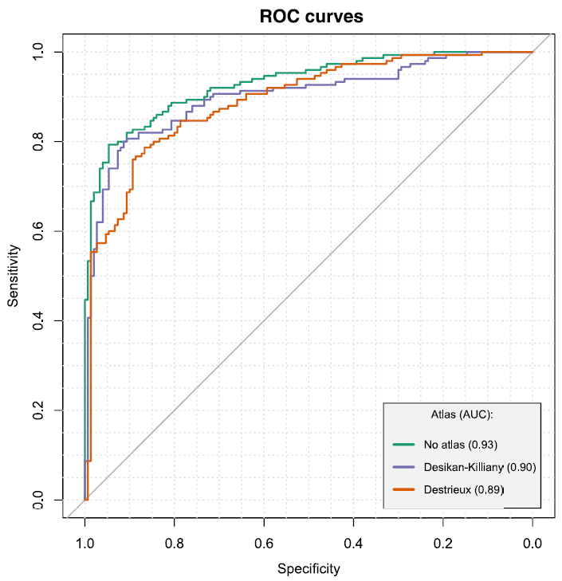
Results
morphometric modalities (AD/HC). The figure illustrates ROC-curves of the models trained with different morphometric inputs. Three inputs demonstrate competing (HD) cortical thickness, volumetric data and combined parcellated measurements. AD/HC
Effect of cortical parcellation using DK and D atlases on AD/HC performance. ROC curves differed significantly when compared to one from the model trained using nonparcellated high-dimensional measurements (p-values: 0.002 and 0.009 — for Desikan- Killiany (DK) and Destrieux (D), respectively) differences were non significant between DK and D. AD/HC

Slide 16
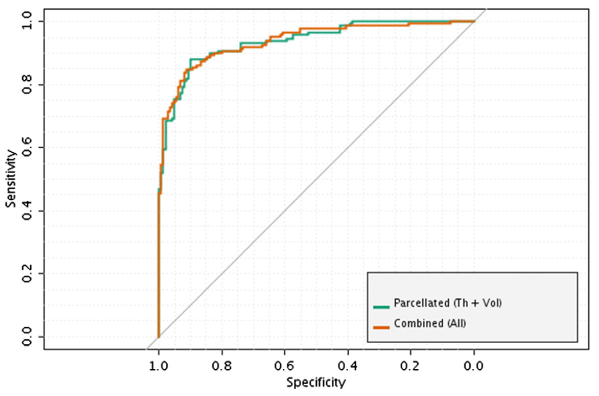
Results
ROC curves: best models (AD/HC). The figure illustrates ROC-curves of the most accurate models trained to differentiate between AD and HC. The model trained using combined parcelled (DK atlas) cortical thickness measures and subcortical volumetric data produced equivalent accuracy compared to the higher-order ensemble model (where all classifiers were combined together by a majority vote

